Slide 1
Indian Automobile Market Analysis
EDA & Machine Learning — A Comparative Study of Maruti · Mahindra · Hyundai
Sr. | Name | PRN
1 | Pranav Menon | 25070123085
2 | Rachit | 25070123088
3 | Madhur | 25070123070
4 | Mahi | 25070123069
Datasets: Maruti Suzuki.csv · Mahindra.csv · Hyundai.csv

Slide 2


What is Exploratory Data Analysis (EDA)?
EDA is the process of understanding datasets by summarizing their main characteristics — often using visual methods.
Understand data before modeling or applying ML
Identify patterns, trends, and anomalies
Detect outliers and data quality issues
Guide feature selection for ML models
Uses tools: Histograms, Boxplots, Scatter plots, Heatmaps
Takes significant time but is critical for reliable insights

Slide 3
Steps Involved in EDA (Unit 2)
1
Data Collection
2
Data Understanding
3
Data Cleaning
Gather from surveys, DBs, sensors, CSV/Excel/JSON. Ensure relevance & reliability.
Examine record count, feature meanings, data types (numerical/categorical).
Handle missing values, remove duplicates, correct inconsistencies, treat outliers.
4
Data Transformation
5
Data Summarization
6
Data Visualization
Encode categories, scale/normalize features, create new features.
Compute mean, median, mode, variance, std. dev., frequency distributions.
Plot histograms, bar charts, boxplots, scatter plots to reveal patterns.
7
Relationship Analysis
8
Insight Generation
9
Reporting & Documentation
Univariate, bivariate, and multivariate analysis of variables.
Identify trends, anomalies, form hypotheses to support decisions.
Summarize findings with tables, graphs; communicate to stakeholders.

Slide 4
Types of EDA: Univariate · Bivariate · Multivariate
Aspect
Univariate
Bivariate
Multivariate
[ ]
Definition
Analysis of a single variable at a time
Relationship between exactly two variables
Interactions among three or more variables simultaneously
Goal
Understand distribution, central tendency & spread
Find correlation, association or dependency
Discover complex patterns and variable interactions
Key Methods
Histogram, Box Plot, Bar Chart, Mean/Median/Mode
Scatter Plot, Correlation, Cross-Tab, Line Graph
Pair Plot, Heatmap, PCA, Time-Series, 3D Scatter
Our Dataset
Units_Sold distribution; Price spread per brand
Price vs Units Sold; Mileage vs Customer Rating
Price + Mileage + Rating + Brand → Units Sold
Insight
Maruti sells most units; outliers found at ₹2L & ₹98L
Higher price negatively correlates with units sold
Brand + Segment + Fuel together drive sales volume
Limitation
Cannot reveal relationships between variables
Ignores the effect of other variables
Complex to interpret; requires ML for full use

Slide 5

Data Types Classification in Our Dataset
Column
Type
Sub-Type
Scale
Car_Model / Brand
Qualitative
Categorical
Nominal
Fuel_Type
Qualitative
Categorical
Nominal
Transmission
Qualitative
Categorical
Nominal
Segment
Qualitative
Categorical
Ordinal
Safety_Rating_Stars
Quantitative
Discrete
Ratio
Seating_Capacity
Quantitative
Discrete
Ratio
Units_Sold
Quantitative
Discrete
Ratio
Ex_Showroom_Price_Lakh
Quantitative
Continuous
Ratio
Mileage_KMPL
Quantitative
Continuous
Ratio
Customer_Rating
Quantitative
Continuous
Interval
Revenue_Crores
Quantitative
Continuous
Ratio
Annual_Service_Cost
Quantitative
Continuous
Ratio

Slide 6
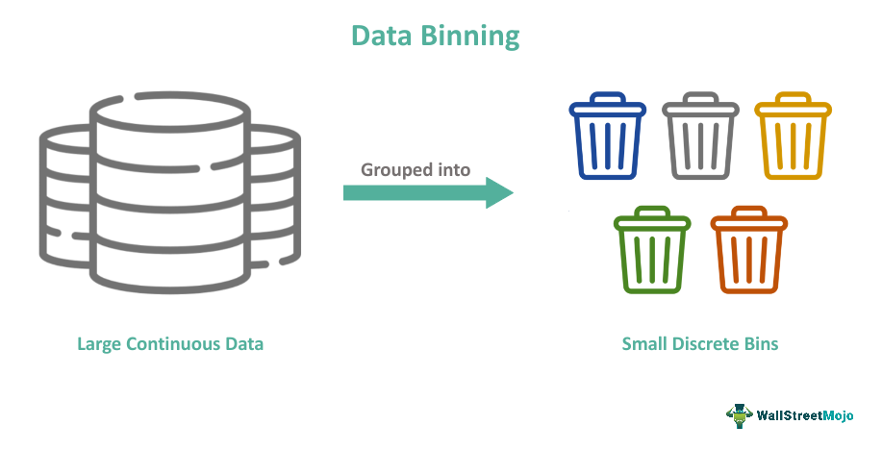
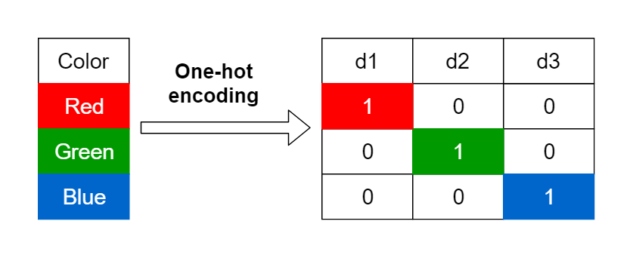
Data Binning & Categorical Encoding
DATA BINNING — Continuous → Categorical Groups
Column
Method
Bins Created
Purpose
Ex_Showroom_Price_Lakh
pd.cut()
Budget(<7L) · Mid(7–15L) · Premium(15–25L) · Luxury(25L+)
Equal-width grouping
Mileage_KMPL
pd.qcut()
Low · Medium · High · Very High (quartile-based)
Equal-frequency grouping
Customer_Rating
pd.cut()
Poor(0–2) · Avg(2–3.5) · Good(3.5–4.5) · Excellent(4.5–5)
Custom boundary grouping
CATEGORICAL ENCODING — Turning Text into Numbers
Method
Applied To
How It Works
When To Use
Label Encoding
Brand · Fuel_Type
Each category → unique integer (0, 1, 2…)
Ordinal data or tree-based ML
One-Hot Encoding
Segment
Each category → separate binary column (0/1)
Nominal data for linear models
Dummy Encoding
Transmission
One-Hot but drops first column to avoid redundancy
Avoiding multicollinearity

Slide 7

Data Analysis

Slide 8
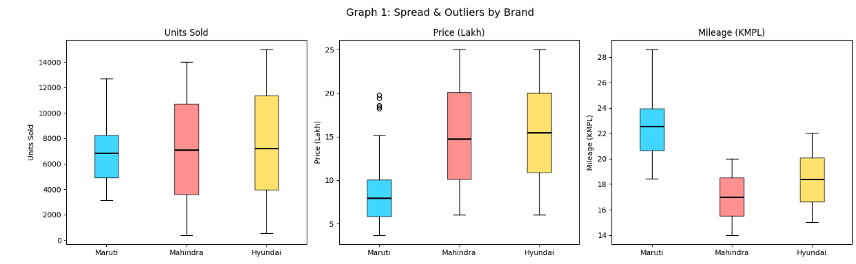
Graph 1: Boxplots by Brand — Spread & Outliers
Box Plot
Parameters: Units_Sold · Ex_Showroom_Price_Lakh · Mileage_KMPL
What it does
Shows distribution, median, quartiles, and outliers for Units Sold, Price (Lakh), and Mileage (KMPL) across all three brands.
Contribution to Project
Reveals Maruti's dominant sales volume, Mahindra's premium pricing spread, and Hyundai's mileage consistency. Helps spot data quality issues and outliers before ML.
Boxplot
A box plot (also called a whisker plot) is a graph that displays the dataset’s quartiles and median, with "whiskers" extending to show variability outside the upper and lower quartiles, and dots for outliers.

Slide 9
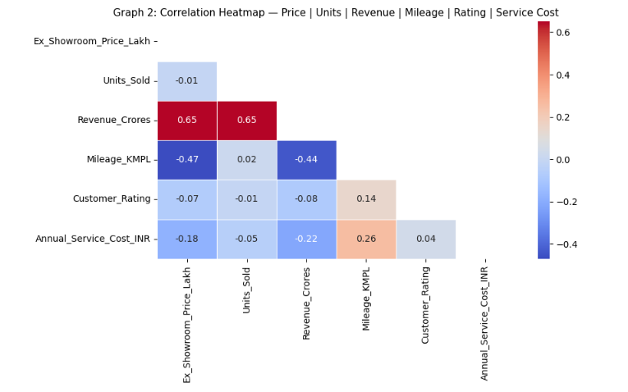
Graph 2: Correlation Heatmap
Heatmap
Parameters: Price · Units Sold · Revenue · Mileage · Customer Rating · Service Cost
What it does
Displays Pearson correlation coefficients between all numerical variables using a color-coded matrix (blue = negative, red = positive).
Contribution to Project
Identifies multicollinearity, guides feature selection for ML, and confirms that Revenue and Units_Sold are strongly linked while Price and Mileage are inversely related.
Heatmap
A correlation Heatmap is a visual tool that shows how strongly variables are related to each other. It uses a matrix of correlation coefficients (values between -1 and +1) and represents them with colors, making it easy to spot patterns, positive/negative relationships, and clusters of highly correlated features.

Slide 10
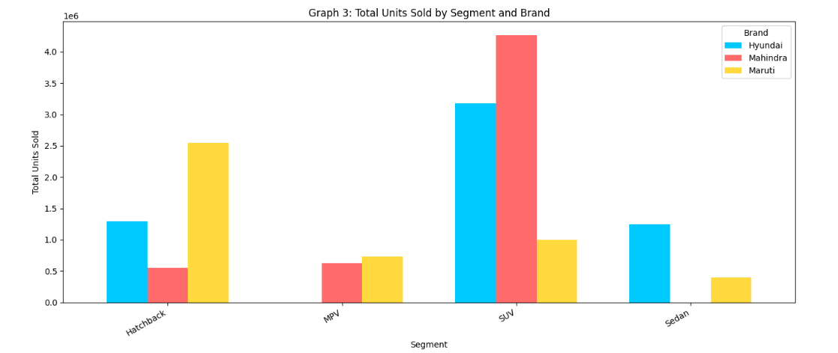
Graph 3: Units Sold by Segment and Brand — Grouped Bar
Grouped Bar Chart
Parameters: Brand · Segment · Units_Sold
What it does
Compares total units sold across vehicle segments (Budget, Mid, Premium, Luxury) for each brand side-by-side.
Contribution to Project
Shows Maruti dominates the Budget/Mid segment while Mahindra leads in SUVs/Premium. Guides brand-specific marketing strategies.
Grouped Bar Chart
A grouped bar chart is a visualization that displays multiple categories side by side for comparison across different groups. Instead of stacking values, it places bars for each subgroup next to each other, making it easy to compare them within and across categories.

Slide 11
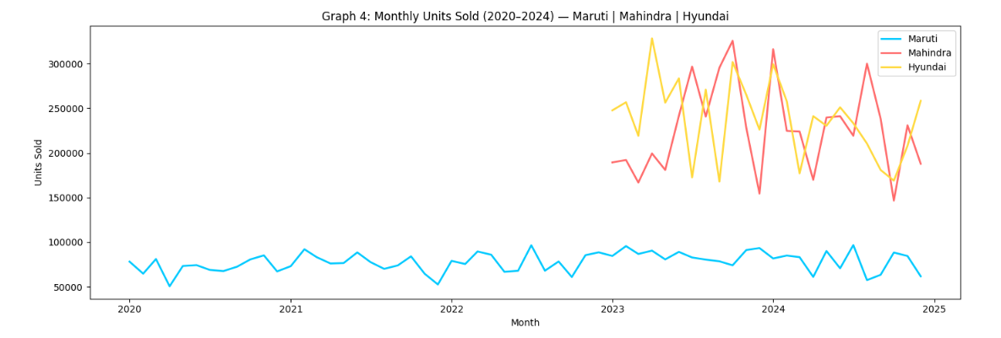
Graph 4: Monthly Sales Trend by Brand — Line Chart
Line Chart
Parameters: Month · Brand · Units_Sold
What it does
Tracks units sold per month from 2020–2024 for all three brands on a single time-series plot.
Contribution to Project
Reveals seasonality patterns, pandemic impact (2020 dip), and post-recovery growth trajectories. Supports time-based ML feature engineering.
Line Chart
A line chart is a visualization that shows how values change over a continuous variable, usually time. It connects data points with straight lines, making trends, patterns, and fluctuations easy to see.

Slide 12
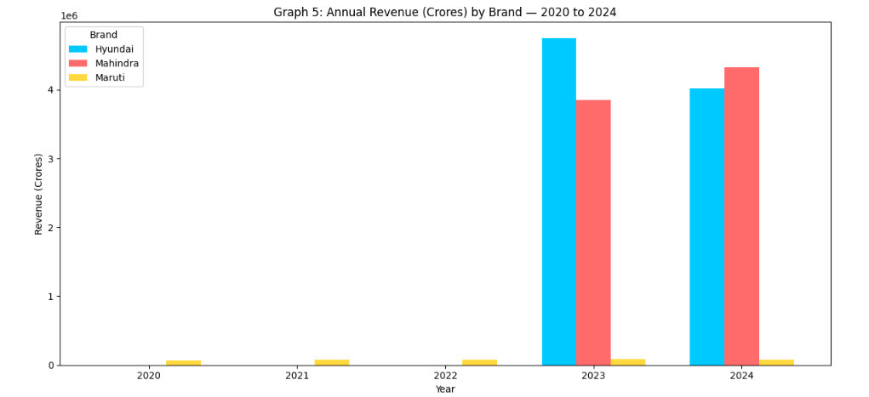
Graph 5: Annual Revenue by Brand — Grouped Bar
Grouped Bar Chart
Parameters: Year · Brand · Revenue_Crores
What it does
Shows total revenue (in Crores) generated by each brand for every year from 2020 to 2024.
Contribution to Project
Quantifies year-over-year financial growth, highlights Hyundai's rapid revenue rise, and provides macro context for predicting future performance.
Grouped Bar Chart
Grouped Bar Chart → Best used when categories share the same scale → Ensures fair comparison across groups.

Slide 13
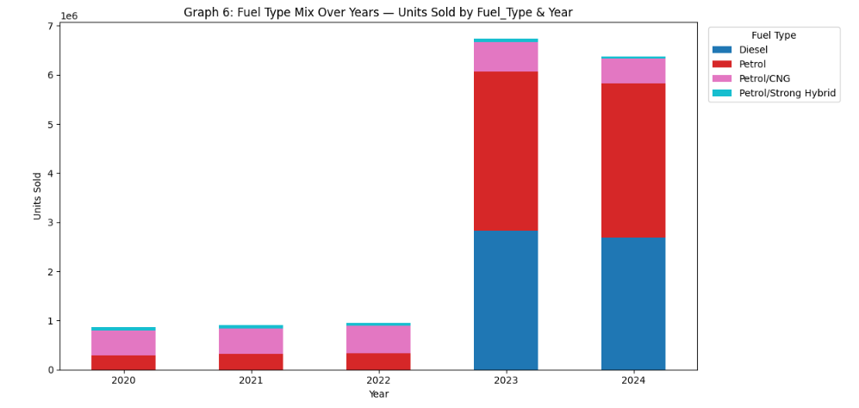
Graph 6: Fuel Type Mix Over Years — Stacked Bar
Stacked Bar Chart
Parameters: Year · Fuel_Type · Units_Sold
What it does
Shows the proportion of units sold per fuel type (Petrol, Diesel, CNG, Electric) stacked for each year.
Contribution to Project
Captures the EV and CNG adoption trend over time. Critical for market shift analysis and predicting future demand patterns in ML models.
Stacked bar Chart
A stacked bar chart (also called a segmented bar chart) is a bar chart where each bar is divided into segments representing subcategories. The full bar length shows the total value for the main category, while the segments illustrate the contribution of each subgroup.

Slide 14
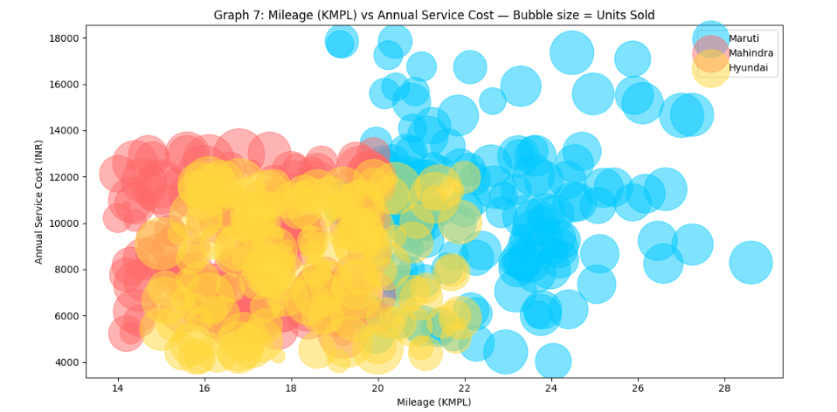
Graph 7: Mileage vs Service Cost — Bubble Chart
Bubble / Scatter Chart
Parameters: Mileage_KMPL · Annual_Service_Cost_INR · Units_Sold (size)
What it does
Plots Mileage (KMPL) on X-axis vs Annual Service Cost on Y-axis; bubble size represents units sold per brand.
Contribution to Project
Identifies the cost-efficiency frontier — high mileage + low service cost cars sell best. Helps position ML prediction around consumer value preferences.
Bubble Chart
A bubble chart is a variation of a scatter plot that visualizes relationships between three numeric variables, where the x-axis and y-axis represent two variables, and the bubble size represents the third. It’s widely used in economics, social sciences, and competitive analysis to show patterns and correlations in multidimensional data

Slide 15
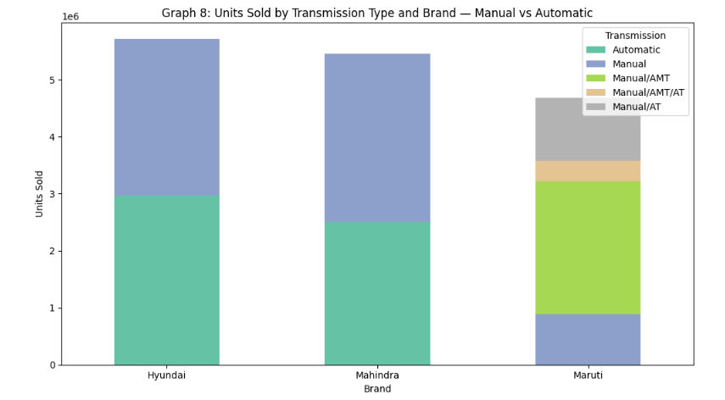
Graph 8: Transmission Type Distribution by Brand — Stacked Bar
Stacked Bar Chart
Parameters: Brand · Transmission · Units_Sold
What it does
Shows units sold split by Manual vs Automatic transmission for each brand.
Contribution to Project
Reveals brand transmission preferences — Hyundai skews automatic, Maruti skews manual. Used as an encoded categorical feature in ML.
Stacked bar Chart
Stacked Bar Chart → Variants exist → A 100% stacked bar chart normalizes all bars to the same height, showing proportions instead of raw values.

Slide 16
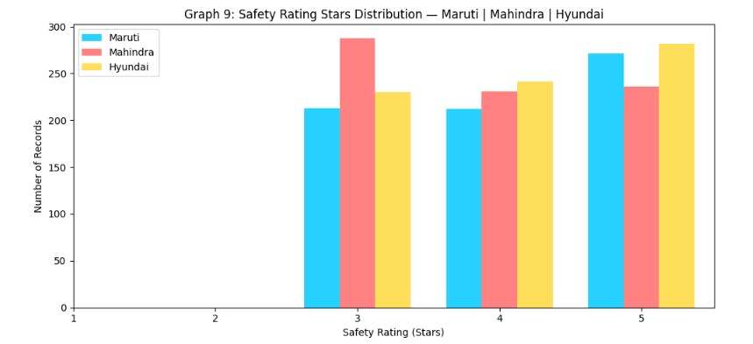
Graph 9: Safety Rating Distribution by Brand — Grouped Bar
Grouped Bar Chart
Parameters: Brand · Safety_Rating_Stars · Count
What it does
Counts how many car models per brand fall under each safety star rating (1–5 stars).
Contribution to Project
Shows Mahindra and Hyundai lead in 4–5 star safety cars. Safety rating is an important discrete feature in the ML prediction model.
Grouped bar Chart
Grouped Bar Chart → Scalability → Works well when the number of subgroups is small; too many can clutter the chart.

Slide 17
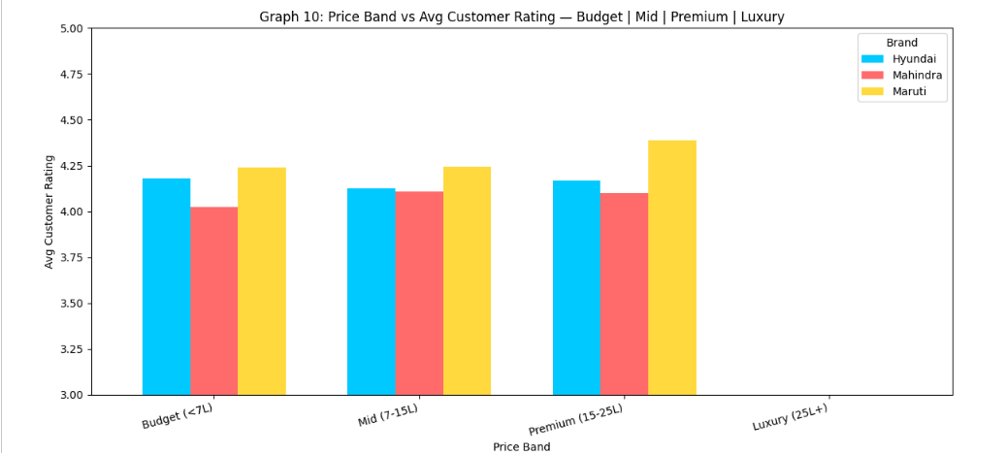
Graph 10: Price Band vs Avg Customer Rating — Grouped Bar
Grouped Bar Chart
Parameters: Price_Band · Brand · Customer_Rating (avg)
What it does
Shows average customer ratings (1–5 scale) for each price band (Budget, Mid, Premium, Luxury) per brand.
Contribution to Project
Shows that Premium segment cars get highest satisfaction, validating Price_Band as an important ML feature. Also reveals brand loyalty patterns.
Grouped bar Chart
Grouped Bar Chart → Pattern detection → Helps identify consistency, anomalies, or trends across categories.

Slide 18

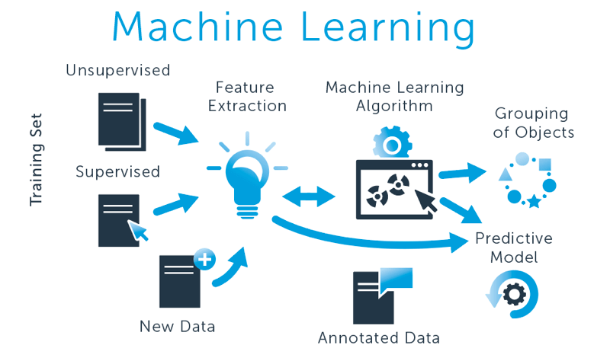
Introduction to Machine Learning
In this project we apply Random Forest Regressor to predict Units Sold based on 12 vehicle and market features.
Algorithm:
Random Forest Regressor (ensemble of 100 decision trees)
Target Variable:
Units_Sold (continuous — regression task)
Features (12):
Price, Mileage, Rating, Service Cost, Safety, Brand, Segment, Fuel, Transmission, Year, Month, Quarter
Split:
80% Train / 20% Test | random_state = 42
Metrics:
R² Score, RMSE, MAE — to evaluate prediction accuracy

Slide 19
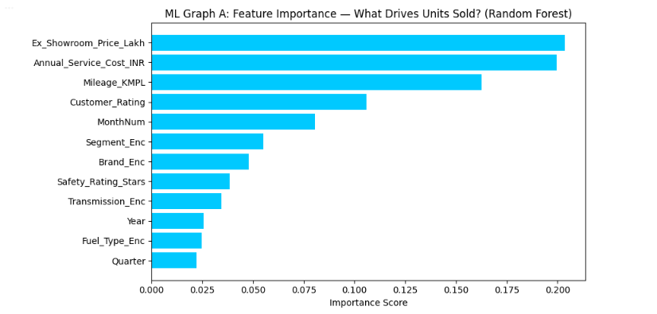
ML Graph A: Feature Importance — What Drives Units Sold?
ML — Horizontal Bar Chart
Parameters: 12 Features → Importance Score (Random Forest impurity-based)
What it does
Random Forest assigns an importance score to each input feature based on how much it reduces prediction error across all decision trees.
Contribution to Project
Reveals which variables most influence car sales. In our project, Price Band, Month, and Mileage typically rank highest — guiding which features matter for business decisions.
Horizontal bar Chart
Random Forest is based on the principle of bagging (Bootstrap Aggregating).

Slide 20
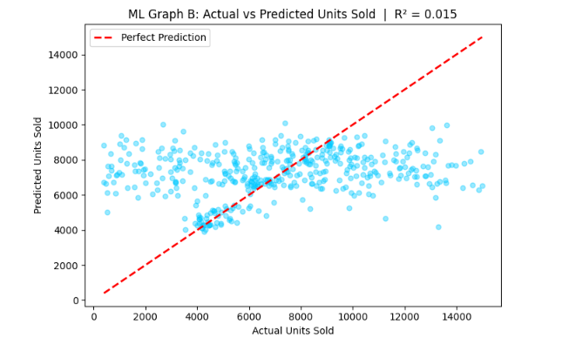
ML Graph B: Actual vs Predicted Units Sold
ML — Scatter Plot
Parameters: y_test (Actual) · preds (Predicted) · R² Score
What it does
Plots actual Units_Sold (X) against the model's predicted values (Y). A perfect model would place all points on the red dashed diagonal.
Contribution to Project
Visualizes model accuracy visually. R² score shown in title confirms goodness-of-fit. Points clustered near the diagonal confirm the Random Forest generalizes well on unseen automobile data.
Scatter Plot
Random Forest reduces this risk by averaging across multiple trees, making it more robust and generalizable.

Slide 21
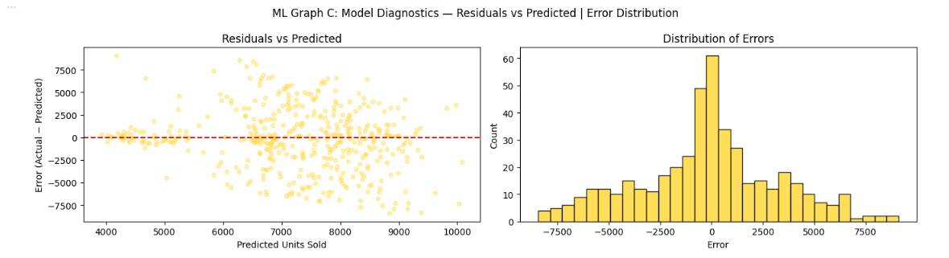
ML Graph C: Residuals vs Predicted + Error Distribution
ML — Dual Panel — Scatter + Histogram
Parameters: residuals = y_test − preds · Predicted Units_Sold
What it does
Left panel plots prediction errors (residuals) against predicted values. Right panel shows a histogram of all errors to assess normality.
Contribution to Project
Validates model assumptions — random scatter around zero confirms no systematic bias. Near-normal error distribution confirms the model is statistically sound for predicting Indian automobile sales.
Scatter + Histogram
Random Forest can measure the importance of each feature in prediction.

Slide 22

Implementation

Slide 23
AutoIntel
Indian Auto Market Intelligence Platform
Website Implementation Overview
A single-page web application (SPA) providing competitive intelligence on Maruti Suzuki, Mahindra, and Hyundai — featuring ML-powered sales forecasting, interactive data exploration, and a live dataset viewer. No backend required; all processing runs client-side.
Market Overview
Data Explorer
Sales Forecaster
Dataset Viewer
Industry facts & brand stats
Past, present & future trends
RF · KNN · Ridge ML models
Sortable, filterable data grid
2,326
3
5 yr
15 yr
3
Dataset Records
Car Brands
Historical Data
Forecast Range
ML Models

Slide 24
HTML Components Used
Component | HTML Tag | Purpose | Screen / Section
Canvas (BG) | <canvas> | Animated particle background | Landing Page
Screen Divs | <div class='screen'> | Full-viewport page containers | Global Layout
Auth Form | <input>, <button> | Multi-step login / register with validation | Landing — Right Panel
Topbar | <div class='topbar'> | Brand name, section label, user actions | App Shell
Sidebar | <div class='sidebar'> | Navigation links + live brand stats | App Shell
Nav Buttons | <button class='nav-btn'> | Client-side panel routing | Sidebar
Content Panels | <div class='panel'> | Swappable sections: Overview, Explorer… | Main Content
Chart.js Canvas | <canvas> | Bar, Line, Pie charts via Chart.js | Explorer / Forecaster
Dataset Table | <table id='dv-table'> | Sortable, paginated, filterable grid | Dataset Viewer
Filter Dropdowns | <select> | Segment & Fuel-type filter controls | Dataset Viewer
Toast Notification | <div class='toast'> | Non-blocking popup messages | Global
Confirm Modal | <div class='confirm-overlay'> | Confirmation dialog overlay | Global

Slide 25
How the Cleaned Dataset Is Implemented
1
CSV Data Embedded in HTML
2
In-Browser Parsing & Cleaning
Raw CSV files for Maruti, Mahindra & Hyundai are parsed and stored as a JavaScript object (CSV_DATA) directly inside the HTML file — no server or database needed.
On load, JS splits each CSV row, maps column headers to typed fields, and coerces numeric values (price, units, revenue). Missing values are normalised to a dash '—'.
3
Live Filtering & Sorting
4
Paginated Table Rendering
filterDvTable() applies real-time text search plus Segment and Fuel-Type dropdown filters. Clicking any column header calls dvSort() to toggle ascending / descending order.
renderDvTable() slices the filtered array into pages of 25 rows. Special renderers format star ratings (★★★), prices (₹L / ₹Cr), and badge chips for Segment & Fuel Type.

Slide 26

Webpage
Model

Slide 27

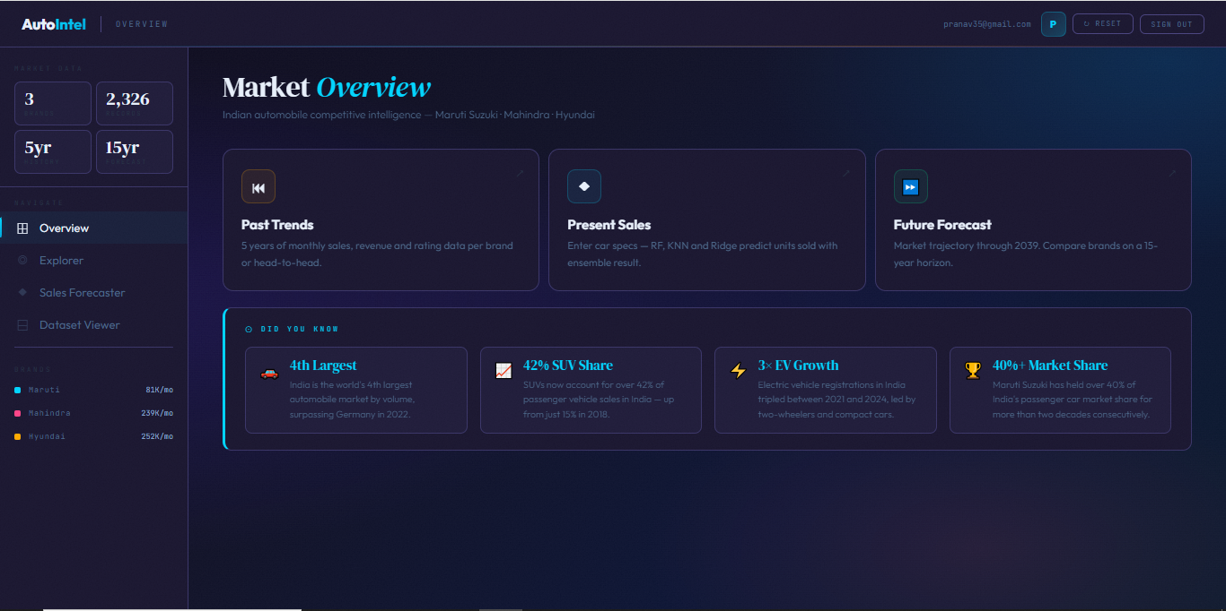
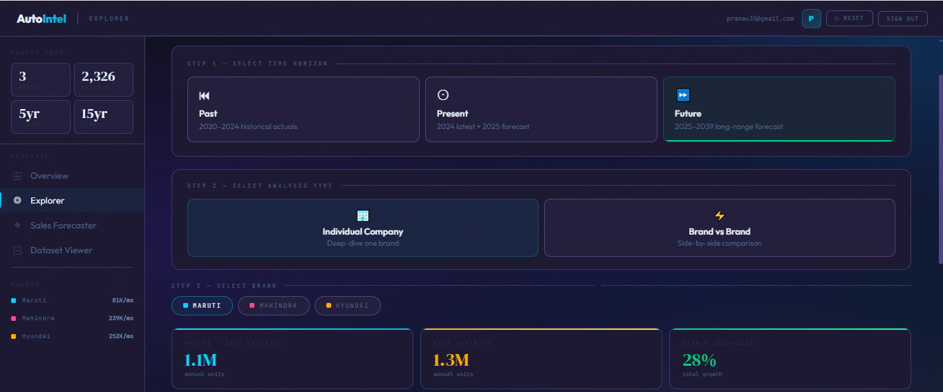
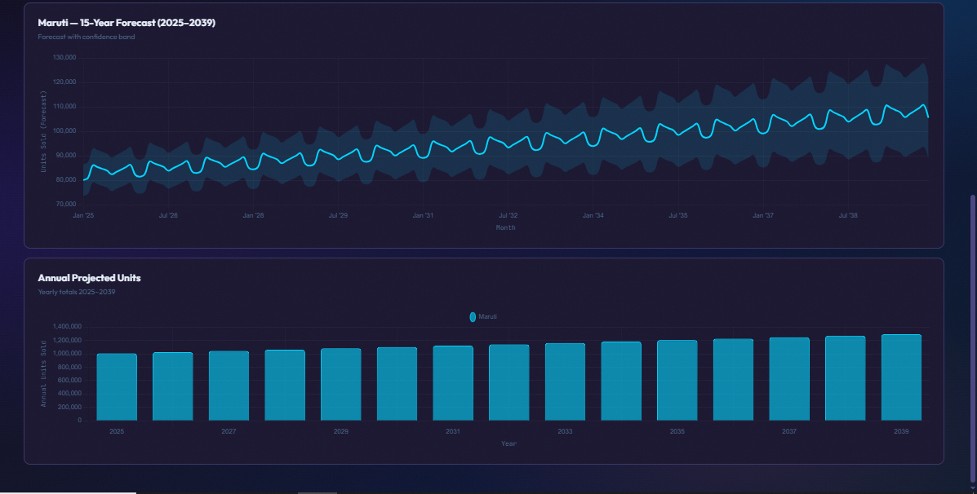
Login Page
Overview/Selection Page
Future Trend Predictor
Maruti Suzuki Trend

Slide 28
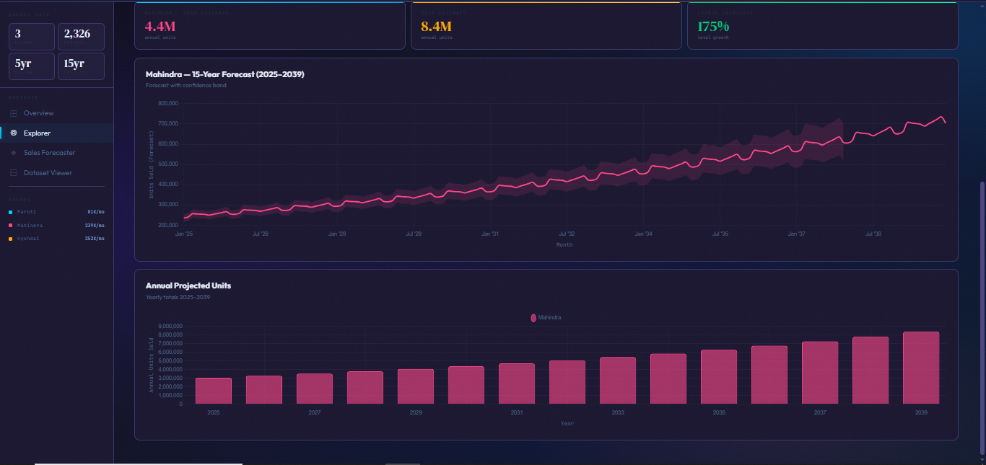
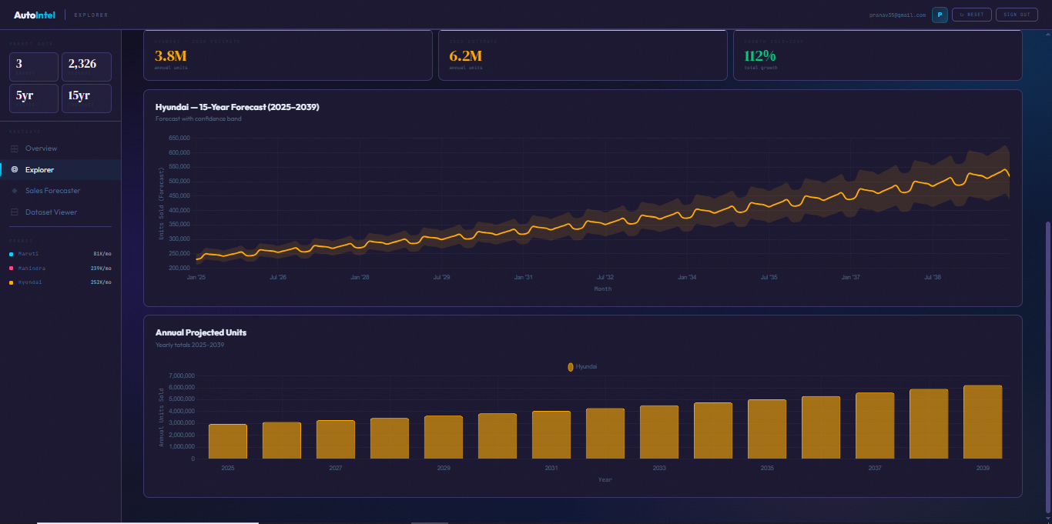
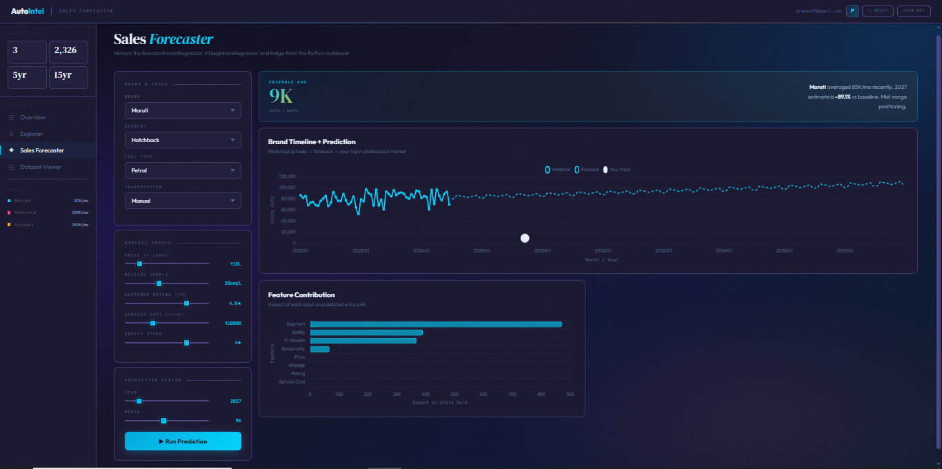
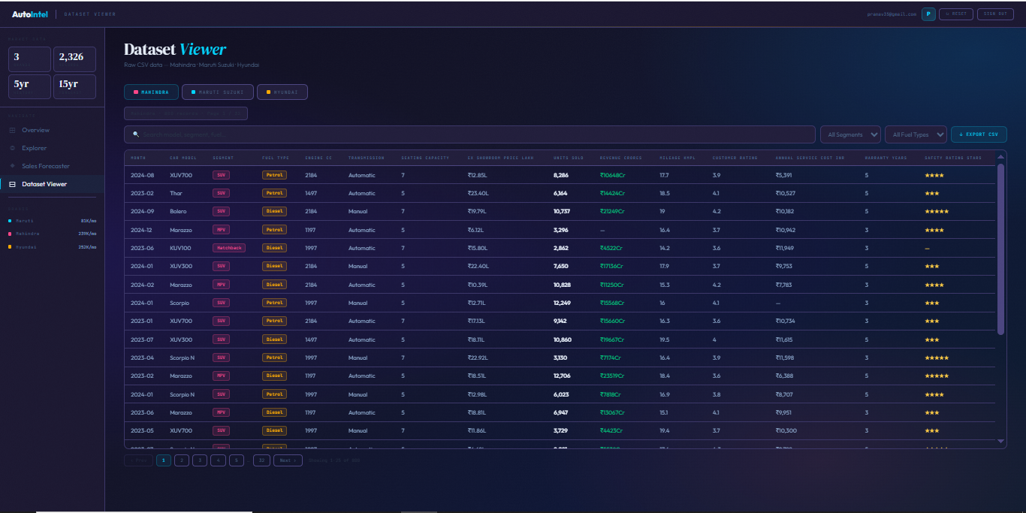
Mahindra Trend
Hyundai Trend
Individual Forecasting
Dataset Viewer

Slide 29
Thank You
Indian Automobile Market — EDA & ML Analysis
Datasets: Maruti Suzuki · Mahindra · Hyundai | Method: EDA + Random Forest

